Slide 1

Deep Adversarial Training for Multi-Organ Nuclei Segmentation in Histopathology Images
HADI NURSALIM
(NPM. 2106779485)

Slide 2
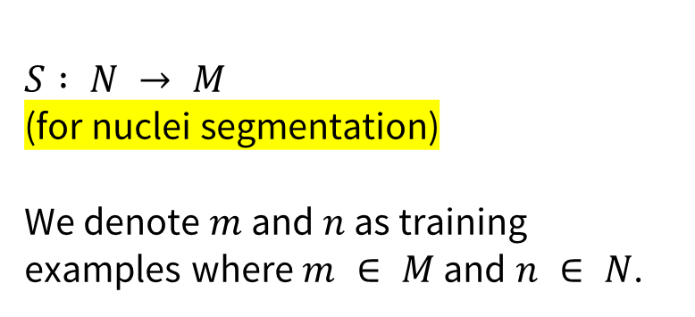
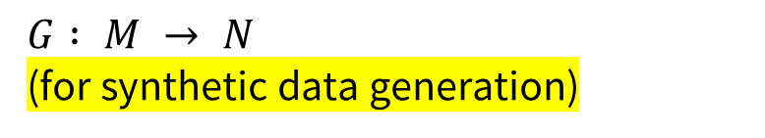
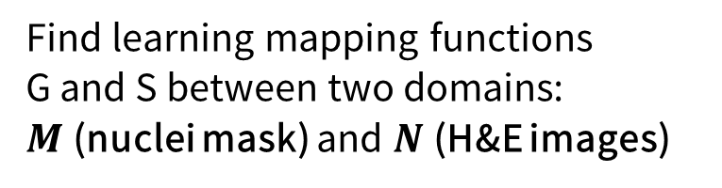
Problems
Find learning mapping functions
G and S between two domains:
$M$ (nuclei mask) and $N$ (H&E images)
Generate synthetic H&E images that model the distribution of cellular and extracellular spatial featuresrepresented in multiple organs.
Use both the synthetic and real histopathology data for training a context-aware CNN that can accurately segment nuclei.
$$G : M → N$$
(for synthetic data generation)
$S : N → M$
(for nuclei segmentation)
We denote $m$ and $n$ as training examples where $m ∈ M$ and $n ∈ N$.

Slide 3
Datasets
Multi organ pathology images (with annotations) of 34 1000 × 1000 pathology images from nine different organs (bladder, colon, stomach, breast, kidney, liver, and prostate, ovary, esophagus)
preprocessing
Sparse stain normalization
Decomposition into large patches of 256 x 256
Training images: four slides from breast, liver, kidney and prostate
Testing images: two slides from breast, liver, kidney, prostate, bladder, colon and stomach and one slide from esophagus and ovary
Adding 4.650 synthetically generated images to training images (nuclei segmentation)

Slide 4
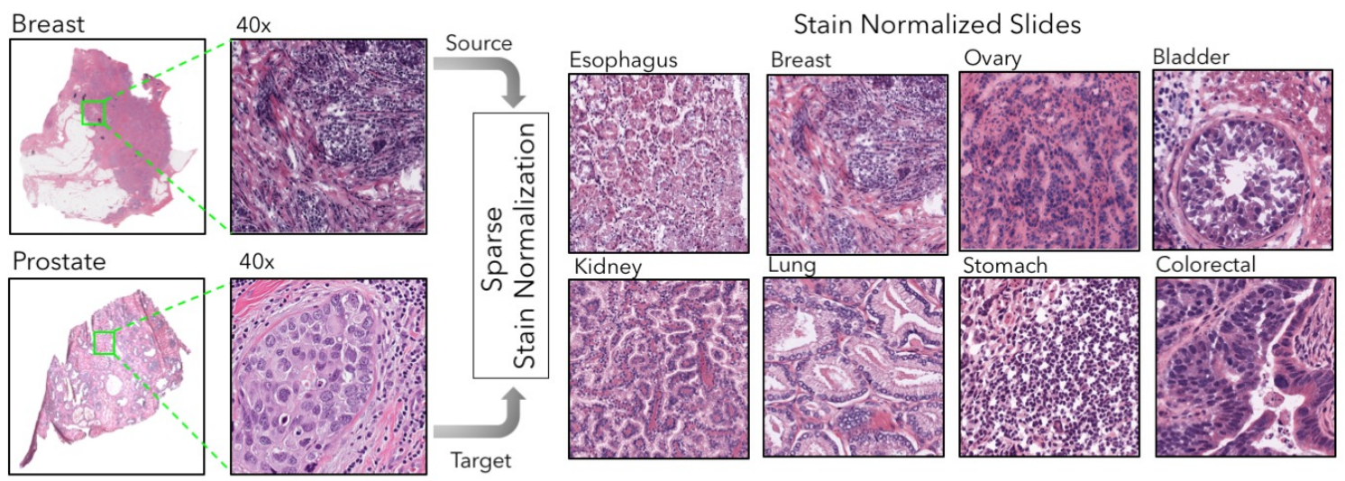
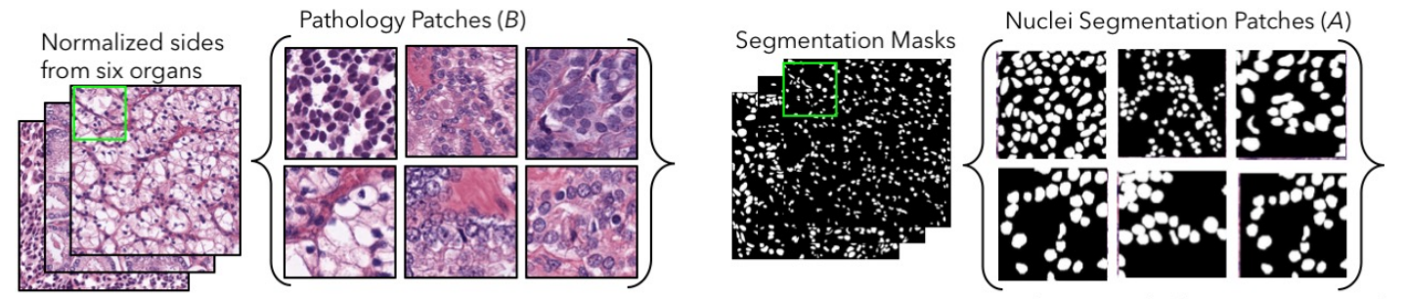

Slide 5
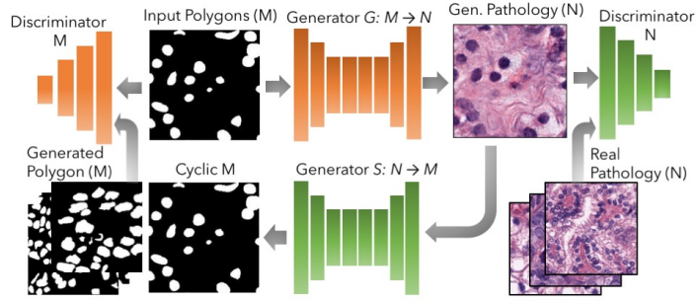
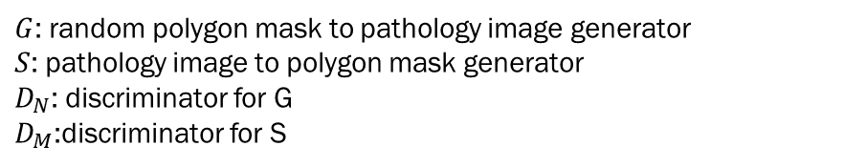
Problem 1: Synthetic data generation
Architectures: dual-GAN (with cycle consistency loss) → cycleGAN
Normalization: spectral normalization (to prevent mode colapse)
The cycleGAN framework learns a mapping between randomly generated polygon masks and unpaired pathology images. Since cycleGAN is based on consistency loss, the setup also learns a reverse mapping from pathology images to corresponding segmentation or polygon masks. The reverse mapping is used only to train the forward mapping more effectively.
$G$: random polygon mask to pathology image generator
$S$: pathology image to polygon mask generator
$D_{N}$: discriminator for G
$D_{M}$:discriminator for S

Slide 6
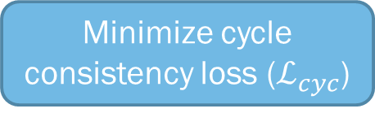
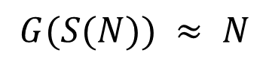
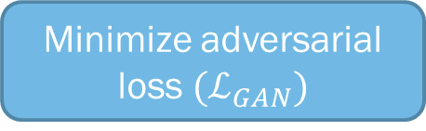
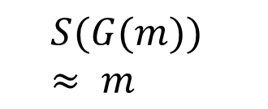
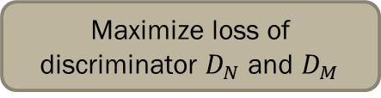
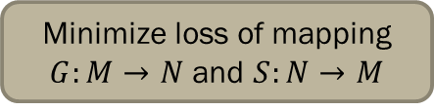
Minimize adversarial loss $(ℒ_{GAN})$
Minimize loss of mapping $G:M→N$ and $S:N→M$
Binary Cross Entropy (BCE) loss of discriminator in classifying real or fake
The adversarial loss is used to match the distribution of translated samples to that of the target distribution
Maximize loss of discriminator $D_{N}$ and $D_{M}$
Objectives
Minimize cycle consistency loss ($ℒ_{cyc}$)
Forward cycle consistency
$$S(G(m)) ≈ m$$
The cycle consistency loss term penalizes deviation from the source image. It ensures that the forward and back translations between the random polygon mask and nuclei image are lossless and cycle consistent.
Backward cycle concistency
$$G(S(N)) ≈ N$$

Slide 7
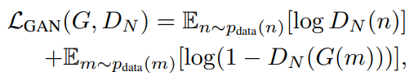
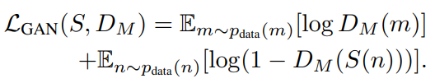
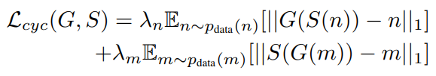
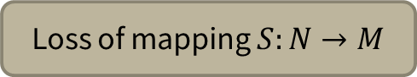
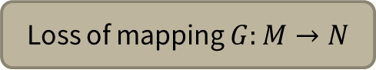

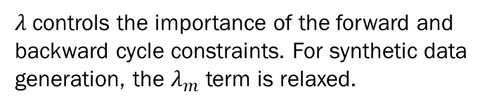
Loss of mapping $G:M→N$
Loss of mapping $S:N→M$
Loss of mapping $S:N→M$
full objective for synthetic data generation
$λ$controls the importance of the forward and backward cycle constraints. For synthetic data generation, the $λ_{m}$ term is relaxed.

Slide 8
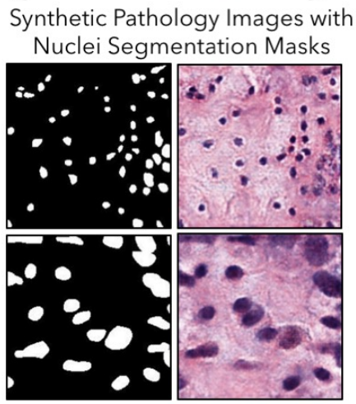
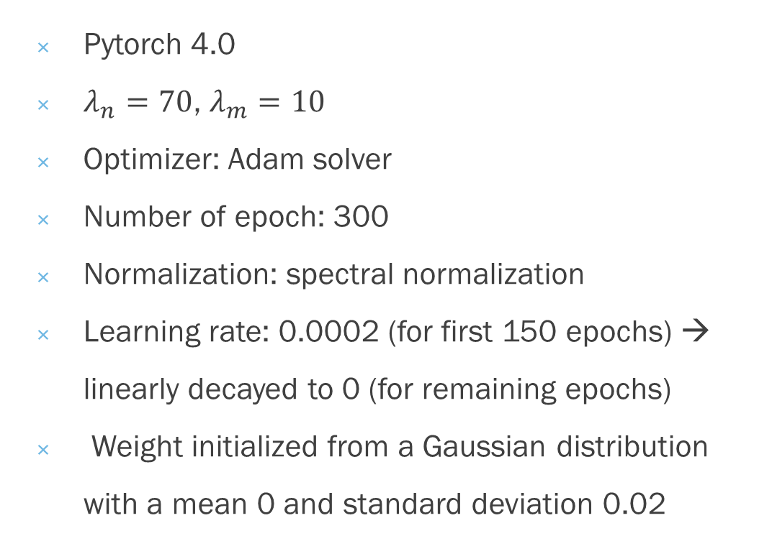
Training Details
Pytorch 4.0
$λ_{n}=70$, $λ_{m}=10$
Optimizer: Adam solver
Number of epoch: 300
Normalization: spectral normalization
Learning rate: 0.0002 (for first 150 epochs) → linearly decayed to 0 (for remaining epochs)
Weight initialized from a Gaussian distribution with a mean 0 and standard deviation 0.02
Output

Slide 9
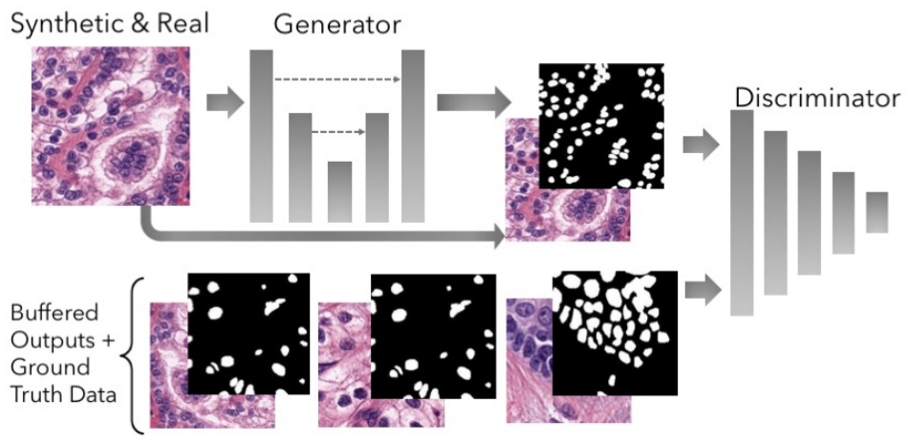
Problem 2: Nuclei segmentation
Architectures: cGAN (conditional GAN)
Normalization: spectral normalization (to prevent mode colapse)
Conditional GANs can learn a structured context-aware loss considering a
larger receptive field. The cGAN framework learns a mapping S for nuclei segmentation, in which S can adapt H&E nuclei images to their segmentation masks.

Slide 10
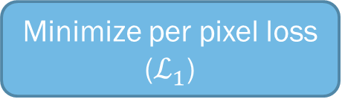

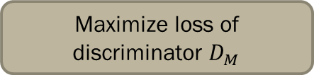
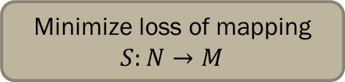
Minimize adversarial loss $(ℒ_{GAN})$
Minimize loss of mapping $S:N→M$
Binary Cross Entropy (BCE) loss of discriminator in classifying real or fake
The adversarial loss is used to match the distribution of translated samples to that of the target distribution
Maximize loss of discriminator $D_{M}$
Objectives
Minimize per pixel loss ($ℒ_{1}$)
to penalize both the joint configuration of pixels and segmentation errors

Slide 11
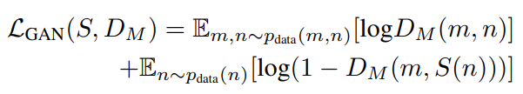
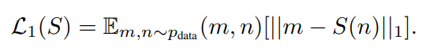
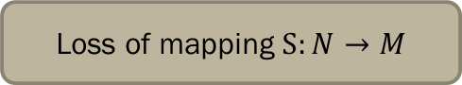
Loss of mapping $S:N→M$
S is penalized if the group configuration of the pixels in the predicted mask is unrealistic, i.e. masks that look like salt-and-pepper noise.
full objective for conditional GAN segmentation
Pixel loss

Slide 12
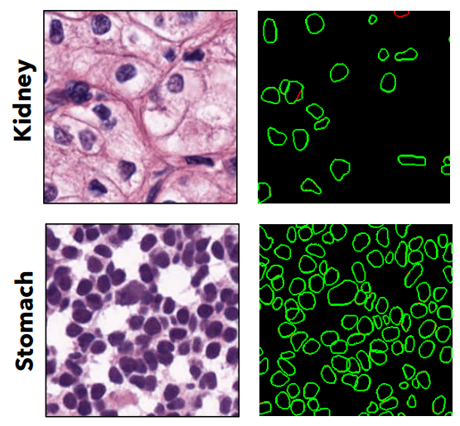
Training Details
Pytorch 4.0
Random jitter (resize image to 286 x 286 → crop back to 256 x 256)
Optimizer: Adam optimizer
Number of epoch: 400
Normalization: spectral normalization
Learning rate: 0.0002 (for first 200 epochs) → linearly decayed to 0 (for remaining epochs)
Weight initialized from a Gaussian distribution with a mean 0 and standard deviation 0.02
Randomly select 64 patch pairs of segmented output and ground truth to be used in the discriminator
Output

Slide 13
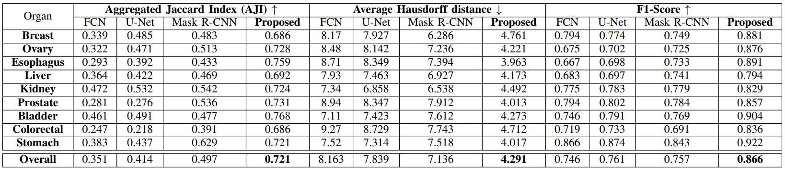
Results
The segmentation networks demonstrates a 29.19% improvement in AJI as compared to DIST and 42.98% as compared to CNN-3C. In terms of standard architectures there is a 44.27% improvement over standard Mask R-CNN and 73.19% over a U-Net.

Slide 14
Resources
Mahmood, Faisal dkk. (2018). Deep Adversarial Training for Multi-Organ Nuclei Segmentation in Histopathology Images.

Slide 15
Thank You

